Slide 1
HCTSA & Epsilon Machine
Integrating CSSR into HCTSA library

Slide 2
Aims
Compare CSSR with other operations in HCTSA
Is there any operations similar to CSSR ? (e.g. produce similar results)
Incorporate CSSR with HCTSA
HCTSA will include more master operations and features.

Slide 3
Dimensions of CSSR
Number of characters in the alphabet set
how to read the continuous data into a sequence of symbols used by Epsilon machine. (e.g. Median split)
Input sequence
Each epoch has its own epsilon machine (will be implemented in HCTSA)
History length (2 ~ 10)
Significance levels (0.001 ~ 0.01)
Single line, multi-line

Slide 4
Outputs of CSSR
Statistical complexity Cu
Cu of forward e-machine
Cu of backward e-machine
Causal irreversibility I
Cu of bidirectional e-machine
KL divergence
Epsilon machine
The finite state machine with transitions between causal states, in HCTSA, it can be represented as a TPM (transition probability matrix) ??? what about the states/bits emitted by transitions

Slide 5
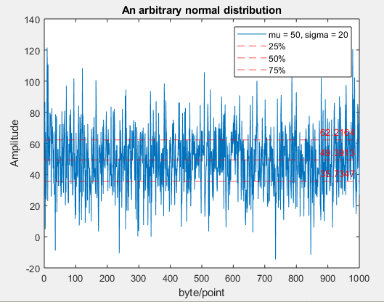
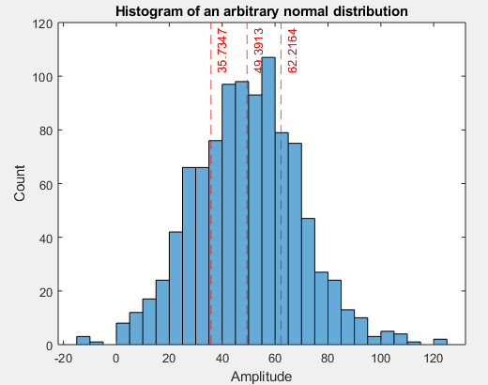
Number of Characters (1)
Question : how to convert a continuous time series into a discrete one?
More precisely, how to define states?
Binarisation (e.g. 0 and 1)
Median split
Difference split
Multiple Levels
Top split / multi-level split
(similar to the notion of multiple level cell, thus, I named it as multiple level split which may be more intuitive….)
Sorted data vector/ Histogram :
<25% 25~50% 50~75% >75%
[ .... …. …. …. ]

Slide 6
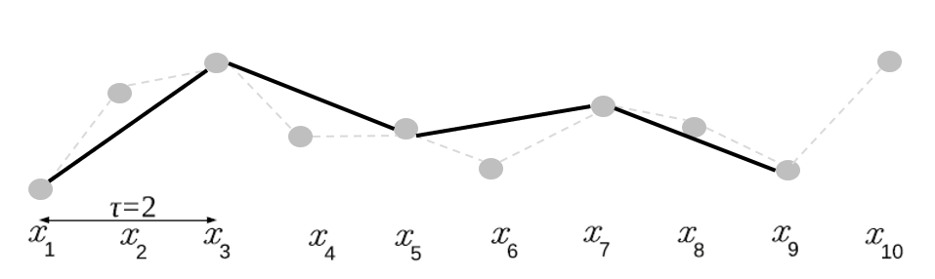
Number of Characters (2) - Symbolic Transformation
Symbolic Transformation (King. et.al 2013)
Capture and summarise dynamical trends of a time series (see figure at the bottom).
Order of ordinal pattern
Number of permutations is (order+1)!
Delay between samples
Delay is the distance between points in ordinal patterns. However, aliasing may occur.
Notes:
wSMI (weighted symbolic mutual information)
This paper used a concept of Bandt & Pompe’s Permutation entropy (PE).
Haohua’s note on symbolic transformation
If my understanding is incorrect, feel free to correct it.
If delay is greater than 1 (tau = 2 in the figure), although in-between points are ignored, but ordinal pattern can still capture the trend.
This is very similar to how people analyse stock prices. Ordinal pattern sequence will more care about the general trend instead of transient variation.

Slide 7

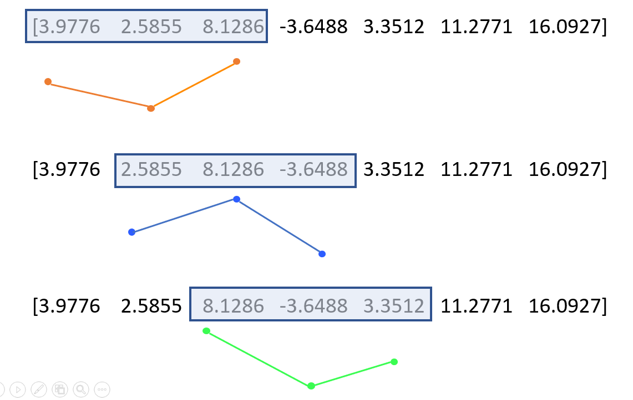
Symbolic Transformation & Permutation Entropy
In permutation entropy, an ordinal pattern is obtained through shifting a window by one point. See this example
(King et.al 2013)
x(3)
??dcbee
x(4)
If order = 2, tau = 1.
x(1) and x(2) can not be defined. Thus x(1) and x(2) are labeled as question mark.
Permutation Entropy - Symbolic transformation
x(5)

Slide 8
Symbolic Transformation - Max Order of Permutation
The implementation of CSSR allows characters that are alphanumeric. From the document of C++ (see isalnum), there are three kind of characters allowed.
Decimal digits 0123456789
Uppercase letter ABCDEFGHIJKLMNOPQRSTUVWXYZ
Lowercase letter abcdefghijklmnopqrstuvwxyz
Hence, the maximum size of alphabet set is |A| = 62.
The number of states/characters in ordinal patterns is (order+1)!
Hence, the range of order is 1, 2, 3
up to (3+1)! = 24 permutations

Slide 9
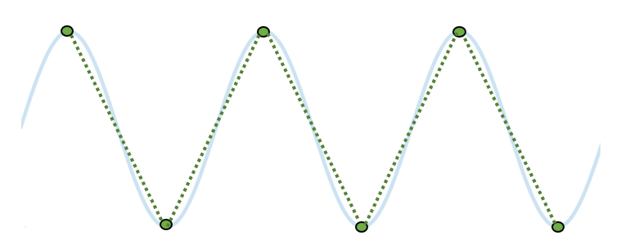
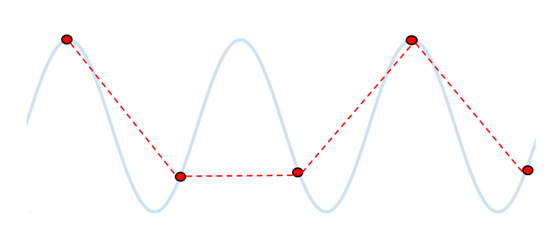
Symbolic Transformation - Potential Aliasing
What is the extreme value of delay?
Ordinal pattern sequence basically samples a continuous time-series.
Hence, the delay of a ordinal pattern sequence is subject to Nyquist sampling theorem.
If delay is greater than one, some components in the high-frequency domain may be missed.
Aliasing may occur if Nyquist sampling theorem is not satisfied.
Due to aliasing, identification of ordinal pattern may be wrong. (see figure below)
A proper ordinal pattern sequence
With aliasing artifacts

Slide 10





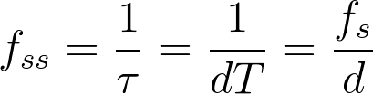
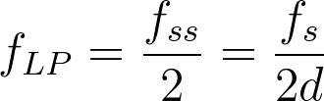


Symbolic Transformation - Potential Aliasing
Sampling rate fs of the input time series and sampling interval T
Aliasing (King et.al 2013)
Assume the highest frequency in the input time series is
The sampling frequency of symbolic transformation is
Time-lag is
Delay in samples is defined as
Nyquist sampling theorem requires
Hence,
To ensure meet Nyquist theorem, a low-pass filter may be used. (remove components higher than which result in aliasing artifacts). The cut-off frequency is

Slide 11
Input Sequence, History Length and Significant level
Discrete Input sequence
Binarisation: median and difference
Top
Symbolic transfer
Maximum history length is determined by a formula in Roberto Munoz’s paper.
L <= log(N)/log(|A|)
N is the length of input data, |A| is the size of alphabet.
Significant level
In the range of [0, 1]

Slide 12
Single-line and Multi-line
In current stage, HCTSA is capable of computing one channel and one segment each time.
HCTSA can only provide one time series to CSSR.
Unfortunately, HCTSA can only use the single-line mode of CSSR in the current stage.

Slide 13
HCTSA & Epsilon Machine
Implementation

Slide 14
CSSR as a MATLAB function
The modified CSSR can read data from Matlab directly without creating any text files.
CSSR returns Cu.
HCTSA compute a numerical value to summary and represent the underlying properties of a given time series.
(If Cu can significantly distinguish epoches, then Cu is a promising metric for HCTSA)
The preliminary CSSR was able to work in my PC (Windows).
Test cases
When I was testing CSSR, I found that longer history length does not necessarily guarantee convergence on the true epsilon machine.

Slide 15
CSSR Errors and theirs Influences
There are three typical issues in CSSR.
(1) CSSR can never synchronize to a state at all;
No results generated at all
(2) it has to re-synchronize at some point;
state_series can not be used.
state_series file is important to temporal asymmetry
(3) it encounters an apparently "impossible" sequence in the data.
It matters only if calculating the relative entropy rate

Slide 16
CSSR and HCTSA

Slide 18
TODO: CSSR and More
Test CSSR across a range of interdisciplinary time-series data.
See https://hctsa-users.gitbook.io/hctsa-manual/analyzing_visualizing/feature-comparison
More complexities….
Cu of forward e-machine
Cu of backward e-machine
Causal irreversibility I
Cu of bidirectional e-machine
HCTSA can compare similarities between operations.
See https://hctsa-users.gitbook.io/hctsa-manual/analyzing_visualizing/feature-comparison

